Slide 1

Using Predictive Analytics to Improve Student Performance
Explore how data-driven insights can help institutions and educators anticipate student needs and improve outcomes.
By Team HardWork
(MEMBERS:- NIRDESH JAIN , SHREYA AGGARWAL, ADITYA ANAND)

Slide 2
Identifying the Problem
Challenges in Current System
Potential Benefits of Analytics
Impact on Student Success
There are gaps in identifying at-risk students, leading to poor outcomes and lower graduation rates.
Useful for early intervention, personalized support, and data-driven insights for educators and administration.
Increased student achievement, better retention, and potentially improved career prospects.

Slide 3
Factors Affecting Student Performance
Study Habits
Effective time management, active participation, and self-regulation can lead to better performance.
1
2
3
Attendance
Extracurricular Activities
Regular attendance is associated with better grades and higher graduation rates.
Participation in clubs, sports, and volunteering can improve motivation, engagement, and social skills.

Slide 4

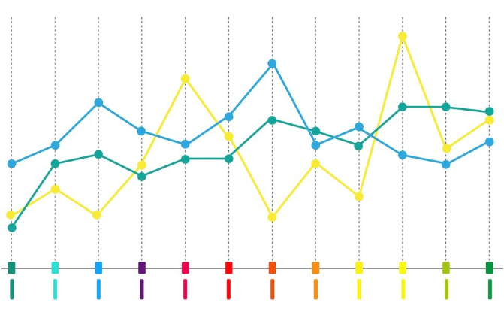
Data Collection and Processing
Data Collection
Data Processing
Collection of data on academic performance, attendance, behavior, extracurricular activities, and demographic information.
Statistical analysis, machine learning algorithms, and data visualization tools used to identify patterns and make predictions.

Slide 5
Analytics and Modelling
1
Regression Analysis
2
Clustering Algorithms
3
Decision Trees
Predictive analysis of academic performance based on attendance, study habits, and demographics.
Visual representation of factors affecting academic outcomes and recommendations for intervention.
Grouping of similar student profiles to identify common characteristics and risk factors.

Slide 6
Results
Improved Student Performance
More Efficient Resource Allocation
Personalised support for at-risk students led to a 10% increase in grades and higher graduation rates.
Analytics-based insights helped prioritize interventions and allocate resources effectively.

Slide 7
Implementation and Support
Training for Educators and Staff
Consent and Privacy
Continuous Monitoring
Ensuring that consent is obtained from students and their families and that privacy rights are respected.
Ensuring understanding of the analytics tool and how it can be used to support students more effectively.
Establishing protocols for monitoring and evaluating the effectiveness of the system on an ongoing basis.

Slide 8

Conclusion
1
The Future of Student Performance Management
Predictive analytics are poised to revolutionize student performance, and educators and administrators need to embrace this technological shift.
2
Benefits for All Stakeholders
From students to educators to administrators, predictive analytics can benefit everyone, leading to better learning outcomes and more productive and supportive learning environments.

